Slide 1
Software Engineering and Programming Basics
Basierend auf dem Material von Oscar Nierstrasz, Sven Apel, Norbert Siegmund

Slide 2
Organization: Overview
People:
Lecture: Prof. Dr.-Ing. Janet Siegmund
Excercise: Shadi Saleh/Student Assistant
Webseiten im OPAL
https://bildungsportal.sachsen.de/opal/auth/RepositoryEntry/21519990789
seBws19/20
Slides
Assignments
Information

Slide 3
Organization: Times
Lecture: 11:30-13:00, 1/219 (New: A13.219)
No lectures: not known, please also look at Web site/OPAL
Excercise:
Weekly
Tuesday, 17:15-18:45, 1/203 (New: A10.203)

Slide 4
Organization
Audience: Master‘s students
Any undergraduates/bachelor‘s students?
Type of lecture:
Lecture: Theoretical background, small examples, discussions
Excercise: Practical Examples, especially programming in a context of a small project
Written exam:
90 Minuten

Slide 5
Literature
Software Engineering. Ian Sommerville. Addison-Wesley Pub Co; ISBN: 020139815X, 7th edition, 2004
Software Engineering: A Practioner's Approach. Roger S. Pressman. McGraw Hill Text; ISBN: 0072496681; 5th edition, 2001
Using UML: Software Engineering with Objects and Components. Perdita Stevens and Rob J. Pooley. Addison-Wesley Pub Co; ISBN: 0201648601; 1st edition, 1999
Designing Object-Oriented Software. Rebecca Wirfs-Brock and Brian Wilkerson and Lauren Wiener. Prentice Hall PTR; ISBN: 0136298257; 1990
However:
No single book for entire lecture
Recommendations per topic
Most of topics are also well described online
StackOverflow!

Slide 6
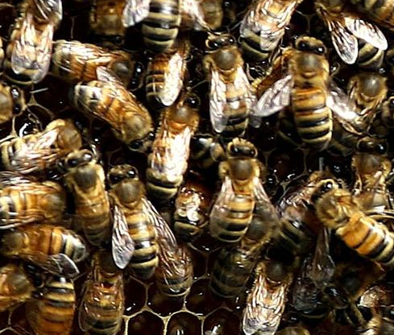
How Does a Lecture Proceed?
Learning Goals (+ Questions for Preceeding Lecture)
Interactive Methods
Buzz groups
Questions
Quiz
Maybe possible exam questions at the end
Notes:
Questions/Dialog: I won‘t force anybody to respond; Maybe those who want to respond can sit up front (next time)

Slide 7

What is Software Engineering?
Notes:
Zeit Folie : Zeit Gesamt (geschätzt)
0 : 35

Slide 8
Software Engineering vs. Computer Science
Computer science is researching theory and basis of computer systems
Software engineering is dealing with practical topics of creating and deploying “good” Software

Slide 9
Why Software Engineering?
Naive view:
Problem specification Final program
However:
Where does specification come from?
How does specification correspond to user requirements?
How does one decide how to structure a program?
How do you decide that the program actually meets the requirements?
How do you know that the program is always working correctly?
How do you react to changing user requirements?
How do you split tasks between different team members?
Coding

Slide 10
Software Engineering Emerged due to Software Crisis
Cost for Software started to become larger than cost for Hardware
Only 34% of software projects completed successfully
Coined during NATO Software Engineering Conference in 1968
"[The major cause of the software crisis is] that the machines have become several orders of magnitude more powerful! To put it quite bluntly: as long as there were no machines, programming was no problem at all; when we had a few weak computers, programming became a mild problem, and now we have gigantic computers, programming has become an equally gigantic problem." –Edsger Dijkstra, 1972

Slide 11
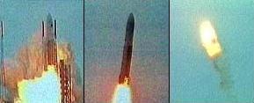
Example Failed Projects: Ariane 5
Ariane 5 Flight 501: June 4th, 1996
Self destruct after 39 seconds
~ 500 million US-$
Quelle(FU): https://www.ima.umn.edu/~arnold/disasters/ariane.html
Notes:
Interne Referenzimplmentierung von Ariane 4 wiederverwendet
Kam vom Kurs ab und sprengte sich selbst

Slide 12
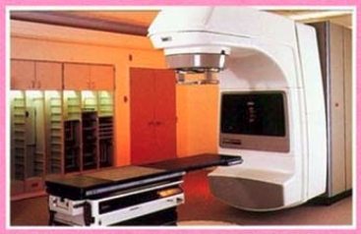
Therac-25
Medical radiation therapy
Due to bug lethal radiation dosage, 3 dead
A single developer wrote software and used available components
Image source (FU): http://cr4.globalspec.com/blogentry/19025/Failure-of-the-Therac-25-Medical-Linear-Accelerator

Slide 13
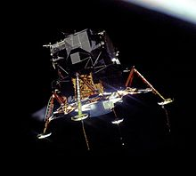
Apollo 11 PGNCS
During landing on the moon:
Unexpected “executive overflow” Alarms
13% of computing resources were used by a bug in the radar (5x Alarm + software reboot)
Image source (PD): https://en.wikipedia.org/wiki/Apollo_11#Lunar_descent
Notes:
Gleichzeitige Ermittlung von Daten durch das Landeradar und des Rendezvous Radars

Slide 14
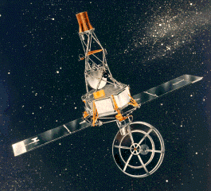
Mariner I
First US venus probe
Rocket self destructed 295s after start because of HW+SW Bug
Image source (PD): http://nssdc.gsfc.nasa.gov/nmc/spacecraftDisplay.do?id=MARIN1

Slide 15
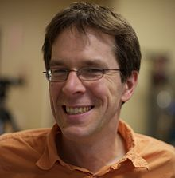
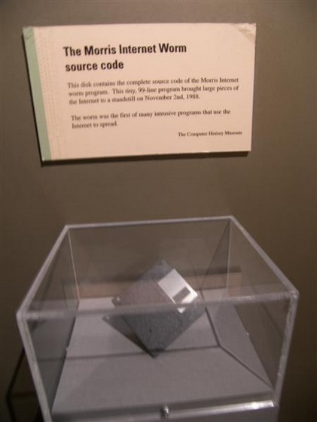
“Morris Worm”
First “computer virus” – accidentally
Designed as research tool to count the computers connected to the Internet (1989)
This bug spread itself
Used 10% of Internert traffic
One PC could be infected more than once
10k-10.000k$
Image source (CC): https://en.wikipedia.org/wiki/Morris_worm#/media/File:Morris_Worm.jpg

Slide 16
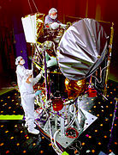
Mars Climate Orbiter
Lost 1999 during descent on Mars
~ 330 Millionen-US-$
Reason: Unit error in sat nav (metric vs. US scale)
Image source (PD): https://en.wikipedia.org/wiki/Mars_Climate_Orbiter

Slide 17
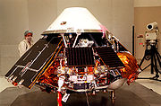
Mars Polar Lander
Lost 1999 during descent on Mars
~ 330 Millionen-US-$
Error in software interpreted vibrations during landing as actual landing and deactivated thrusters too early
Image source (PD): https://en.wikipedia.org/wiki/Mars_Polar_Lander

Slide 18
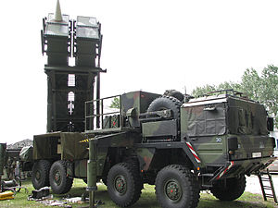
Patriot Missile Disaster
Error in guidance system made it miss the missile to intercept and lead to death of 28 people during golf war in 1991
Reason: error when computing the time caused by inaccurate calculations (everything after 24Bit was truncated, leading to inaccuracies)
Image source (CC): https://en.wikipedia.org/wiki/MIM-104_Patriot
Notes:
[Show what can happen with Eclipse/see Prog 1 lecture]

Slide 19

AT&T Telefonnetzwerk-Crash
AT&T Netzwerk collapsed on January 15th, 1990
Down time of 11 hours,~ 60 Millionen-US-$
"The fault was in the code" of the new software that AT&T loaded into front-end processors of all 114 of its 4ESS switching systems in mid-December, said Larry Seese, AT&T's director of technology development.
Image source (FU): http://www.att.com/gen/press-room?pid=6158&cat=46&u=484

Slide 20

Los Angeles Flugkontroll-Crash
Flight control in LAX crashed on April 30th, 2014
10 canceled and 500 delayed flights
US spy plane confused software
Image source (CC): https://www.flickr.com/photos/usnavy/7261361906/

Slide 21

2003 Northeast Blackout
No electricity for two days in USA/Kanada
~ 10 deaths, 45 Millionen people affected
Bug supressed local alarm, so problem could spread
Image source (CC): https://en.wikipedia.org/wiki/Northeast_blackout_of_2003

Slide 22
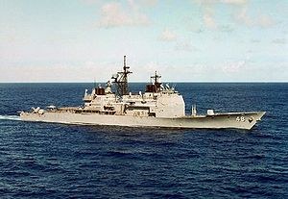
USS Yorktown
Image source (CC): https://en.wikipedia.org/wiki/USS_Yorktown_%28CG-48%29
Testbed for “Smart Ship” program
Ship-wide system crash on Sep 21, 1997 (including engines)

Slide 23
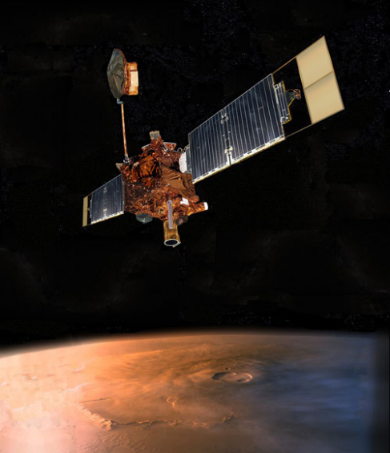
Mars Global Surveyor
Image source (CC): https://en.wikipedia.org/wiki/Mars_Global_Surveyor
Contact lost in 2006
End of successful 10-year mission

Slide 24

Toyota Acceleration Bug
Image source (FU): http://www.toyota-global.com/showroom/emblem/passion/
Causes “unintended acceleration”
May have caused up to 89 deaths

Slide 25
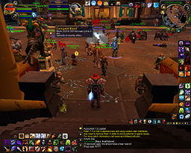
Corrupted Blood Incident
Unintended pandemy in WoW, 2005, 1 week
Was used later by epidemiologists to study how deseases spread
Image source (FU): https://en.wikipedia.org/wiki/File:WoW_Corrupted_Blood_Plague.jpg

Slide 26
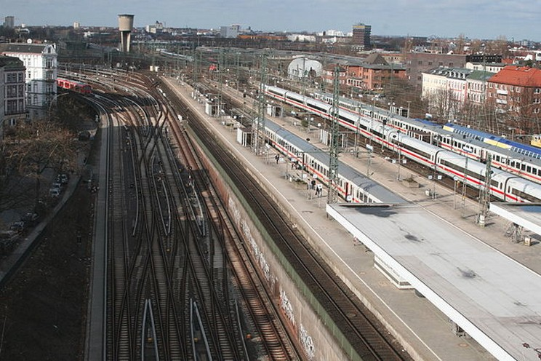
Hamburg-Altona Railway Switch
Computer “upgrade” of switch systems
Entire station had to be shut down for 2 days, 100,000s of passengers affected
Stackoverflow + error in code to catch stack overflow
Image source (CC): https://en.wikipedia.org/.../media/File:Bahnhof_Hamburg_Altona.JPG

Slide 27
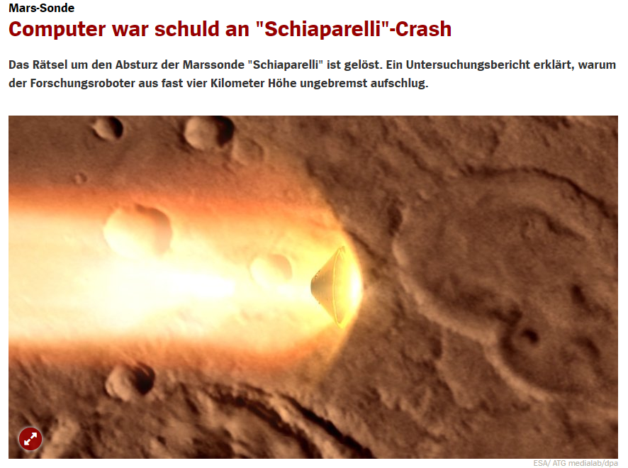
Notes:
Das entscheidende Problem trug sich demnach kurz nach der Öffnung des Bremsfallschirms bei doppelter Schallgeschwindigkeit zu. Zu diesem Zeitpunkt bewegte sich "Schiaparelli" offenbar beim Weg durch die immer dichter werdende Marsatmosphäre stärker als vorhergesehen hin und her. Das wiederum sorgte dafür, dass ein Messgerät, das die Eigendrehung der Sonde überwachte, die sogenannte IMU, überlastet wurde.
Statt wie vom Hersteller versprochen schon 15 Millisekunden nach einer Überlastung wieder betriebsbereit zu sein, blockierte das Problem den Bordcomputer für rund eine Sekunde. Dadurch wiederum wurde aus den Bewegungsdaten eine falsche Höhenangabe berechnet.

Slide 28
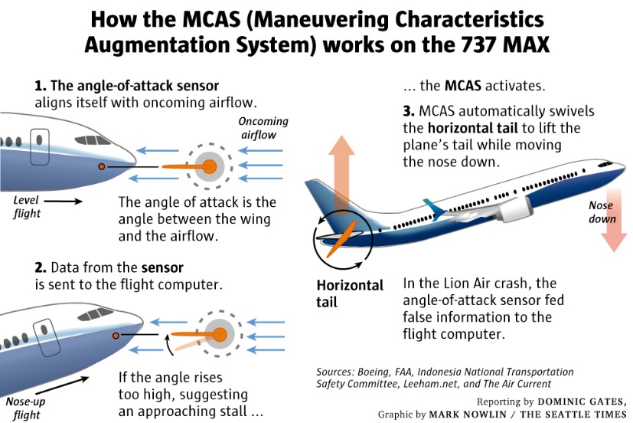
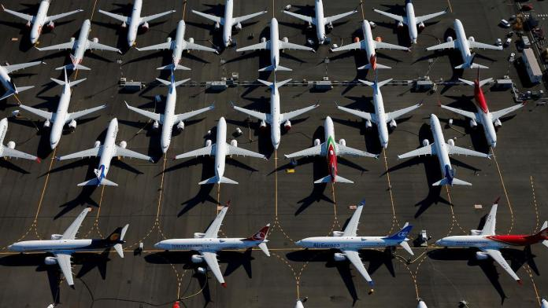
Boing 737 Max
https://www.seattletimes.com/business/boeing-aerospace/failed-certification-faa-missed-safety-issues-in-the-737-max-system-implicated-in-the-lion-air-crash/
Software system MCAS (Maneuvering Characteristics Augmentation System) had security issues and dependent on a single sensor
346 people died; 32$ Mrd. loss, 8$ Mrd. cost
Notes:
Wurde eingebaut, weil ein extremes Flugmanöver, das für die Zulassung geflogen wird, zu ruckelig ablief; dann wurde es in mehreren Schritten geändert, aber die Änderungen wurde nicht der FAA immer mitgeteilt. Eigentlich hatte es anfangs zwei Sensoren als Input, in den Änderungen später aber nur noch einen. Dazu gab es ein Signal, das MCAS eingreift, das aber optional für viel Geld angeboten wurde. Darüberhinaus sollten Piloten ohne neues Training die 737 Max fliegen können, weil das Geld spart und so der Vorteil gegenüber Airbus bestehen bleibt. Piloten ohne Training wussten nicht über MCAS Bescheid (Boeing sagte, es sei nicht notwendig). Die abgestürzte Lion-Air-Maschine wäre am Vortrag auch fast abgestürzt, aber es war zufällig ein Pilot an Board, der eine Schulung für die neue 737 Max hatte und den Piloten sagen konnte, wie sie reagieren sollen.

Slide 29
More Examples for Failed Projects
SAGE System (1951) for finding bombers; not necessary anymore when it was ready to be deployed in 1963
Toll Collect: planned start in August 2003, actual start in January 2006; 3.5 Mrd€
California Driver and Vehicle Licensing Agency aborted project after 6 years and 45 M$
FBI Virtual Case File aborted project 2005 after 3 years und 170 M$
London Stock Market aborted Taurus project 1993 after 11 years und 800 M£ (13200 %)

Slide 30
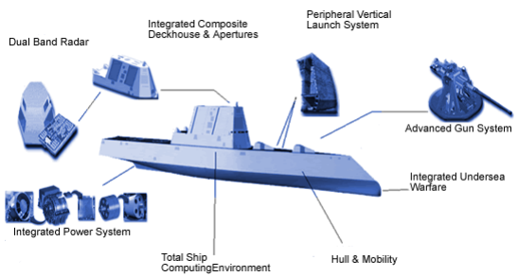
Example for Extrem Complexity
DDX Submarine
Many embedded systems
Approx. 30,000,000 lines of code
In 142 programming languages

Slide 31
Why Do Software Projects Fail?

Slide 32
Gründe für Scheitern
Budget aufgebraucht
Zeit aufgebraucht
Ineffizienz von Software
Schlechte Qualität von Software
Software erfüllt Anforderungen nicht
Projekte waren nicht mehr zu managen und Quelltext schwierig zu warten
Software wurde nie ausgeliefert

Slide 33
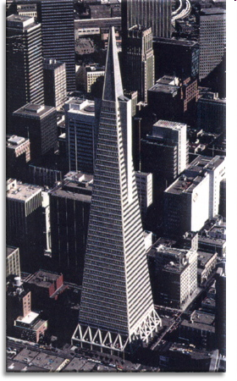

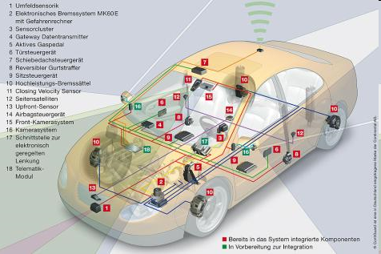
Solution: Software Engineering

Slide 34
Term: Software Engineering
Term was coined at NATO conference in 1968
Idea: software engineering similar to engineering discipline
Different perspectives on software engineering, which we take a closer look at now

Slide 35
Definition: Software Engineering (1)
„state of the art of developing quality software on time and within budget “
State of the art:
Community decision
Life-long learning
Restricted resources

Slide 36
Definition: Software Engineering (2)
„multi-person construction of multi-version software “ -- Parnas
Team work
Successful software systems have to evolve; change is the norm, not the exception

Slide 37
Definition: Software Engineering (3)
„software engineering is an engineering discipline that is concerned with all aspects of software production“ -- Sommerville
Software is a product that is developed for a specific customer
Not only programming, but entire software life cycle

Slide 38
Task
Which processes belong to the software life cycle?
What is the role of programming?

Slide 39
Software Life Cycle -
Start
Programming is a small part of software lifce cycle
Maintenance
Requirements Engineering
Testing
Design
Implementation

Slide 40


Implementation
Foundations of Java programming
Practical experience
Find and fix bugs
Learn to help yourself in the Internet
How do I write readable code?
Notes:
Zeit Folie : Zeit Gesamt (geschätzt)
1 : 16

Slide 41
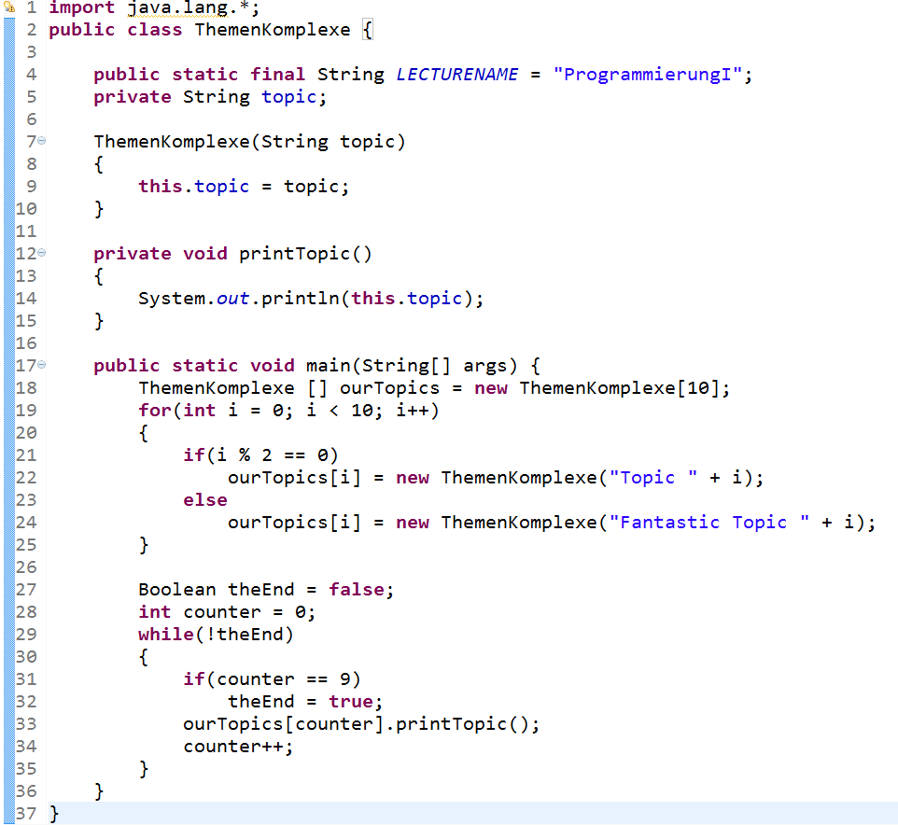
Topics Overview
Java Classes, enumerations, etc.
Variables, constants,
(static vs. instance)
Constructors, assignments,..
Visibility
Methods, parameters,…
Arrays, Lists, Stacks, etc.
OOP: Instantiation
Data types (primitive & complex)
Control structures
(loops, conditionals, etc.)
Notes:
Zeit Folie : Zeit Gesamt (geschätzt)
8 : 24

Slide 42
Possible Exam Questions
Implement a static method in Java for the following operation:
Input: 2-dimensional array with int values
Output: An int value, representing the sum of the largest values of all columns
Example: is 23, since: 5 + 3 + 7 + 8 = 23
Implement a double linked list based on the classes node and list. The list should store objects of type String and have the following methods:
public void display(): prints all elements of the list (i.e., content of the nodes) on the console, starting with the first element
public void add (int i, String content): adds the passed String at position i to the list
public void remove (int i): removes the element at place i from the list
5 | 2 | 7 | 8
3 | 3 | 5 | 4

Slide 43
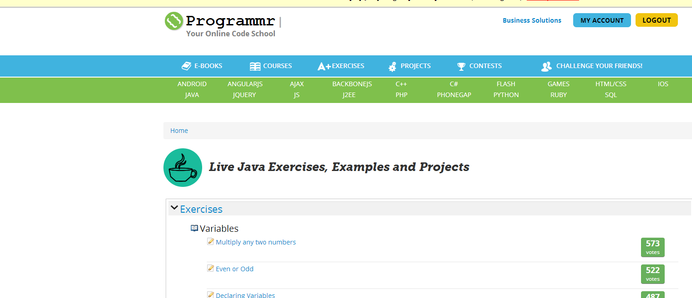
Tips for Practicing
Programmr (http://www.programmr.com/)
http://www.codecademy.com/
https://www.udacity.com/course/intro-to-java-programming--cs046
https://www.codingame.com/start
Notes:
Live Online gehen in Programmr und zeigen, wie das gehen kann. Auch die anderen Webseiten benutzen. Praxis betonen!
Zeit Folie : Zeit Gesamt (geschätzt)
10 : 1h30

Slide 44
Tipps zum Informatikstudium
129 InformatikprofessorenInnen in den USA haben jeweils einen Rat gegeben: https://www.databasestar.com/cs-student-advice/
Anyone can succeed in Computer Science.
Ask questions of your professor if you don’t understand something.
Take a broad view of Computer Science. It’s more than just programming.
Get broad experiences outside Computer Science.
Don’t give up easily.
Ensure you like it for the right reasons.
Find what you like within Computer Science.
Focus on the fundamentals.
Keep learning.
Learn to solve problems.
Make the most of the opportunities offered by the university.
Learn more math.
Practice.
Learn to manage your time well.
Work hard.

Slide 45
Literature
Tutorials
The Java Tutorial, Oracle Corporation, http://download.oracle.com/javase/tutorial/
API Reference
Library of JDK 7, Oracle Corporation, http://download.oracle.com/javase/7/docs/api/
Notes:
Zeit Folie : Zeit Gesamt (geschätzt)
1 : 1h31

Slide 46
Special Literature
Specification
James Gosling, Bill Joy, Guy Steele, Gilad Bracha, Alex Buckley, The Java Language Specification, Java SE 7 Edition, Oracle Corporation, 2012, http://docs.oracle.com/javase/specs/index.html
Programming style
Code Conventions for the Java Programming Language, Oracle Corporation, http://www.oracle.com/technetwork/java/codeconv-138413.html
How to Write Doc Comments for the Javadoc Tool, Oracle Corporation, http://www.oracle.com/technetwork/java/javase/documentation/index-137868.html
Entwicklungsumgebung
Gottfried Wolmeringer, Thorsten Klein, Profikurs Eclipse 3, 2. Auflage, Vieweg 2006, http://www.springerlink.com/content/tk04q4/
!
!
Notes:
Zeit Folie : Zeit Gesamt (geschätzt)
1 : 1h32

Slide 47
Summary
Basic understanding of what software engineering is and what not
Know necessity for software engineering
Understand the role of programming for software development

Slide 48
Take Aways/Possible Exam Questions
What is software engineering?
Name/explain reasons why software projects fail
What ist the software crisis? Why did it happen?
Name/explain the processes of the software life cycle
What are commonalities and differences between software engineering and classical engineering?

Slide 49
Literature
Any software engineering book
Internet

